Slide 1
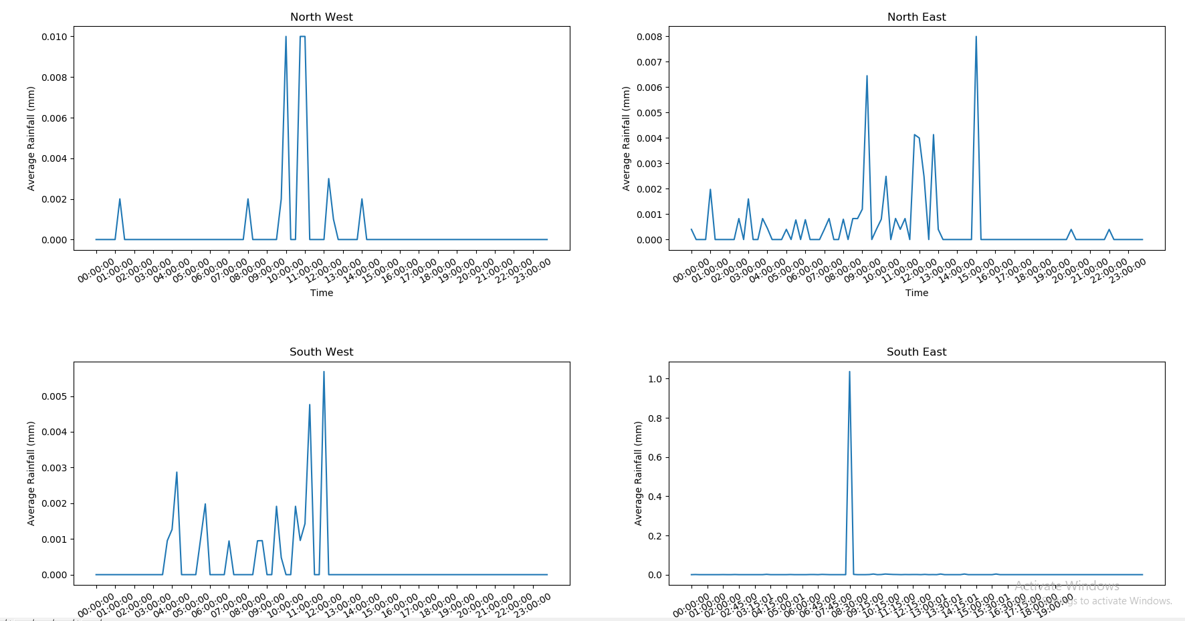
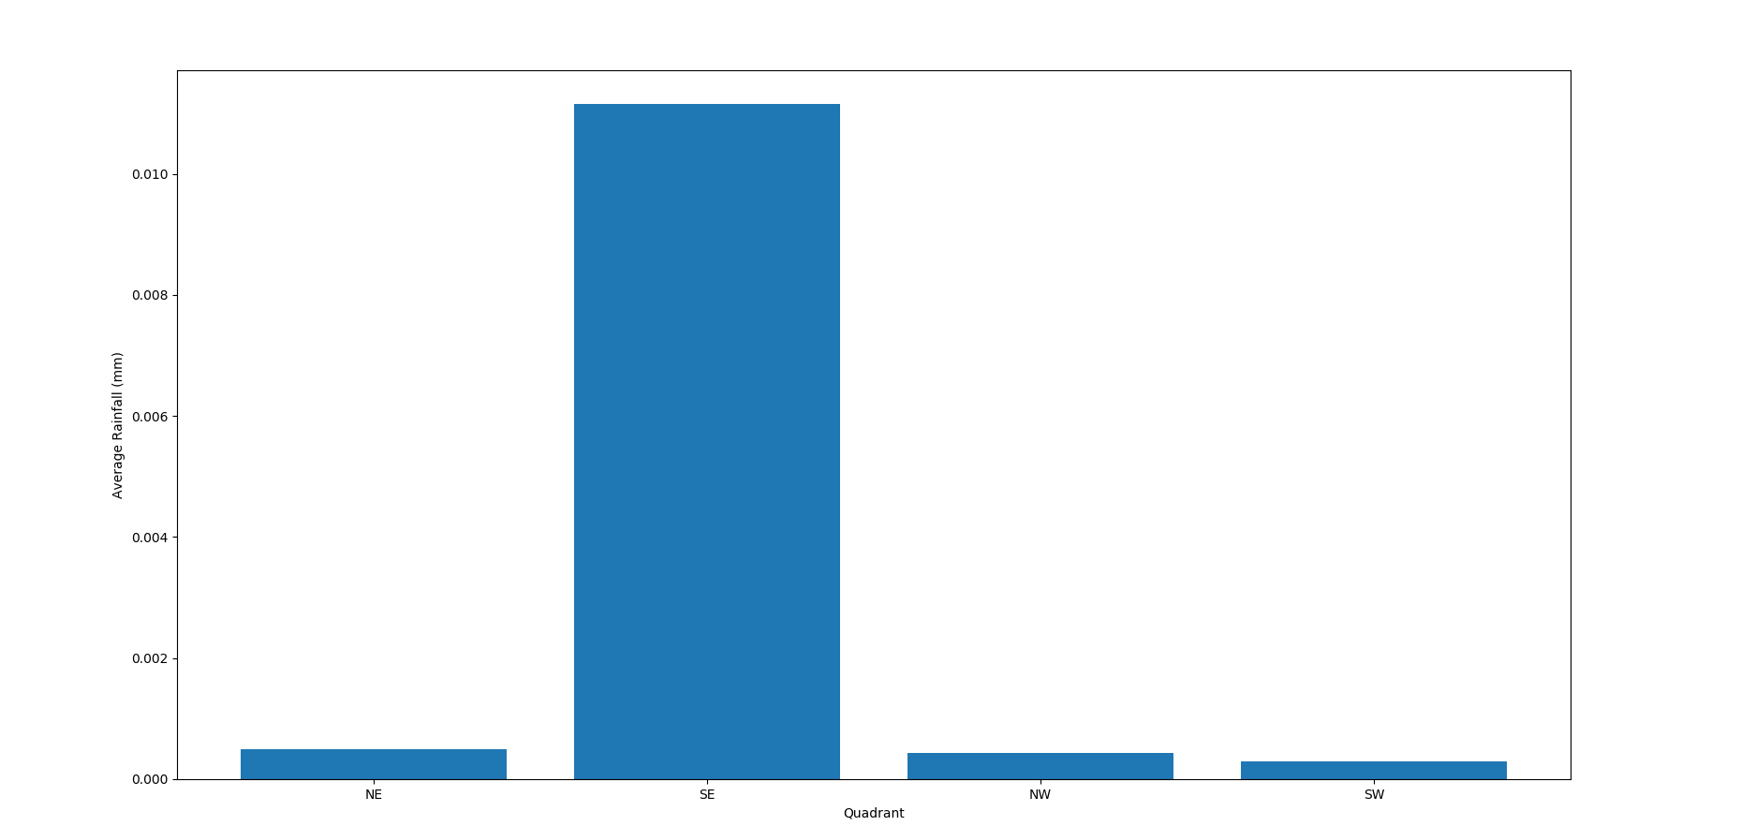
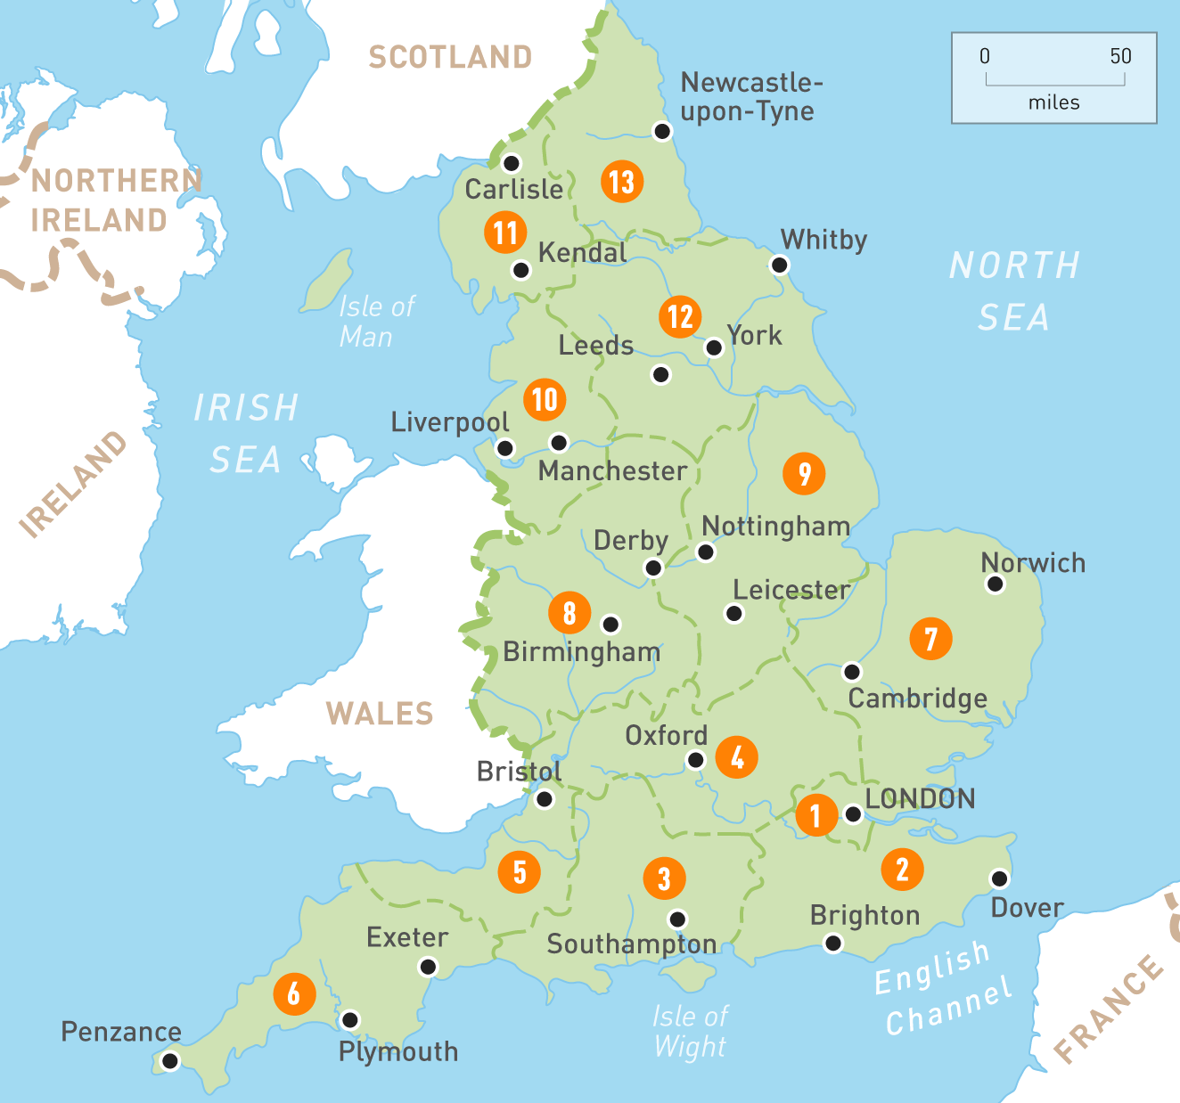
ACSE4: Group Jordan
Average Rainfall Variation on 01/01/2019
Step3: input ‘postcode’ -> ‘rainfall’ & ‘warning alert’ (output the warning alert according to the combination of rainfall and flood risk )
Step4: input ‘specific date’ -> the average rainfall (bar chart) in that day of four areas (consider Leicester as the central city) in England & the historical rainfall variation (line chart) in four areas per 15 minutes in that day
Average Rainfall on 01/01/2019
NW
NE
SW
SE

